Slide 1
Section 7
2022/02/25

Slide 2
Malloc, calloc and vocabulary review
Realloc does does not initialize new data
Vocabulary is an array of an array of characters (Strings)
To allocate an array of pointers we want to be using:
char **vocabulary = (char**)calloc(5, sizeof(char*));
This allocates a space for 5 character pointers
What are they initialised to?

Slide 3
What is the right diagram for what vocabulary looks like?
h
e
l
l
o
0
vocabulary
vocabulary
h
e
l
l
o
0
s
p
o
r
t
0
s
p
o
r
t
0
s
p
a
r
e
0
s
p
a
r
e
0
p
o
i
n
t
0
w
e
d
g
e
0
p
o
i
n
t
0
w
e
d
g
e
0
(a)
(b)

Slide 4
What is the right diagram for what vocabulary looks like?
h
e
l
l
o
0
vocabulary
s
p
o
r
t
0
s
p
a
r
e
0
p
o
i
n
t
0
w
e
d
g
e
0
(b)

Slide 5
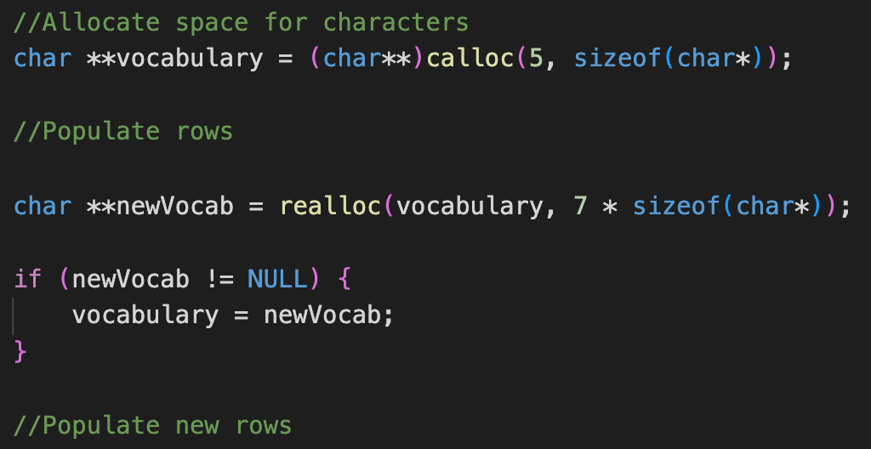
Realloc
vocabulary
NULL
NULL
NULL
NULL
NULL

Slide 6
Realloc
h
e
l
l
o
0
vocabulary
NULL
NULL
NULL
NULL

Slide 7
Realloc
h
e
l
l
o
0
vocabulary
s
p
o
r
t
0
NULL
NULL
NULL

Slide 8
Realloc
h
e
l
l
o
0
vocabulary
s
p
o
r
t
0
s
p
a
r
e
0
p
o
i
n
t
0
w
e
d
g
e
0

Slide 9
Realloc
vocabulary
h
e
l
l
o
0
s
p
o
r
t
0
s
p
a
r
e
0
p
o
i
n
t
0
newVocab
w
e
d
g
e
0
???
???

Slide 10
Realloc
vocabulary
h
e
l
l
o
0
s
p
o
r
t
0
s
p
a
r
e
0
p
o
i
n
t
0
newVocab
???
w
e
d
g
e
0
???

Slide 11
Realloc
h
e
l
l
o
0
s
p
o
r
t
0
vocabulary
s
p
a
r
e
0
p
o
i
n
t
0
w
e
d
g
e
0
h
e
d
g
e
0
s
h
a
r
p
0

Slide 12
score_letter
score(letter | vocabulary) = # words in vocabulary that contain letter
Score of letter, given vocabulary is the number of words in the vocabulary that contain that letter
int score_letter(char letter, char **vocabulary, size_t num_words)

Slide 13
score_word
score(word | vocabulary) = sum(score(letter | vocabulary), for unique letters in word)
The score of the word, given the vocabulary is equal to the sum of the scores of all unique letters in the word
int score_word(char *word, int *letter_scores)
You have all score(letter|vocabulary) calculated in letter_score
What is letter_scores[0]?
What about letter_scores[5]?

Slide 14
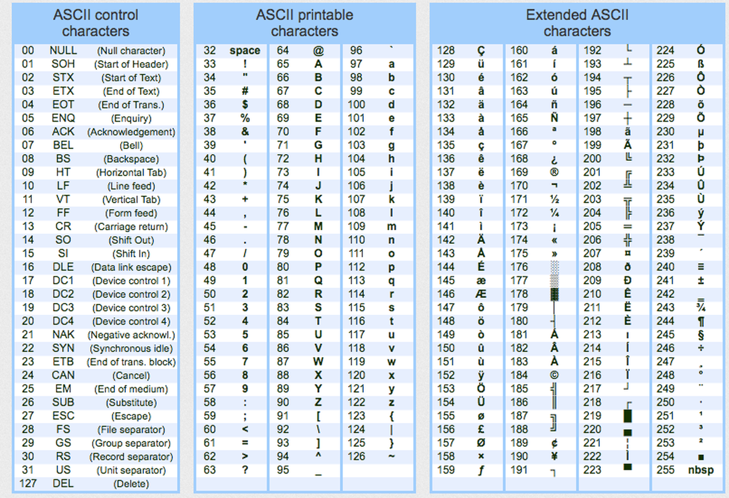
Characters as numbers
How are chars stored?
As a 1 byte number
We can use maths to treat these to index an array!
Lets adjust ‘a’ to be the first index!
What index would letter_scores[‘f’ - ‘a’] access?

Slide 15
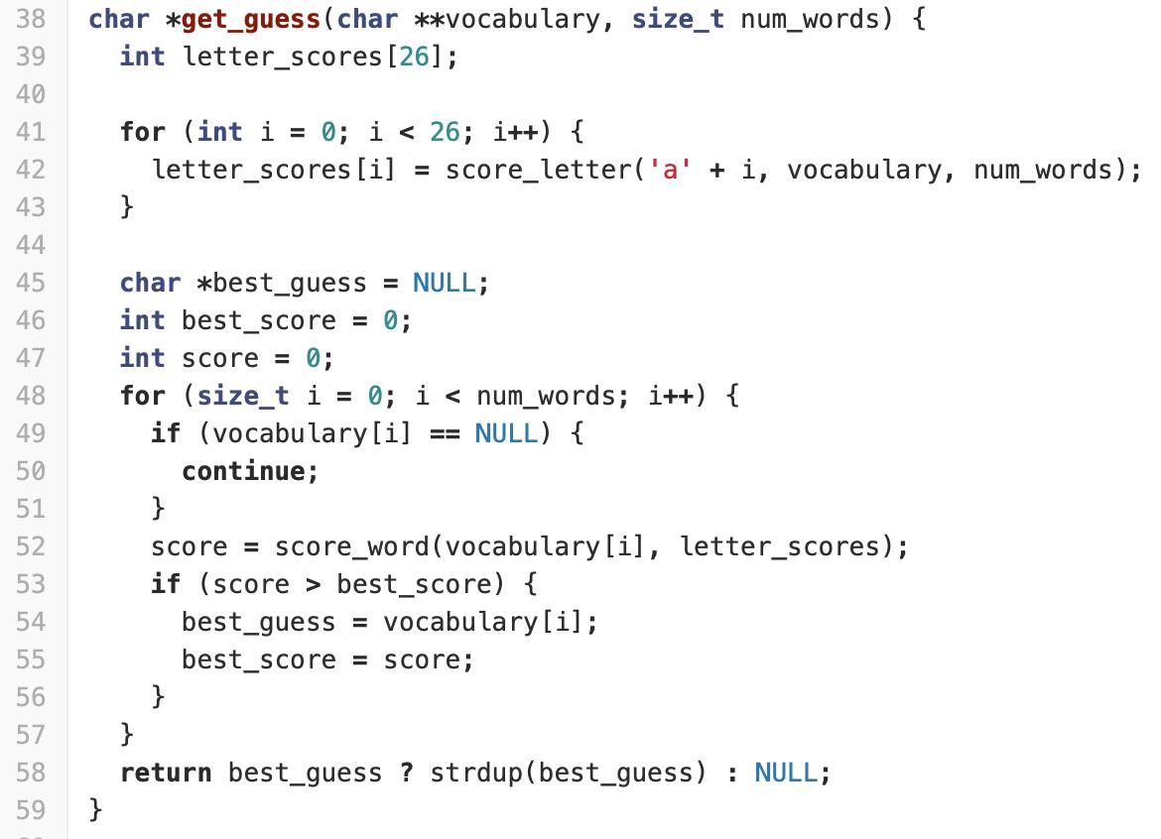
Putting score_letter and score_word together
How should they go together?
Line 42 - What does this do?
Notice the call to letter_scores on line 52
This is where your score_word is called!
Notice letter_scores is already initialised
YOU SHOULD NOT BE CALLING score_letter FROM score_word!

Slide 16
What does letter_scores look like?
What type is it?
Pointer to an int
Variable name indicates plurality
Probably an int array!
How big is the array?
What does it contain?
letter_scores[0] = score_letter(‘a’|vocabulary);
letter_scores[3] = score_letter(‘d’|vocabulary);
How can we translate from letters to indexes?
letter - ‘a’

Slide 17
filter_vocabulary
3 functions for filtering down vocabulary
Green, gray and yellow
Green
Sets any word in the vocabulary to NULL that does not have the given letter at the given position
Yellow
Sets any word in the vocabulary to NULL that (does not contain the letter, or has the letter at the given position)
Gray
Sets any word in the vocabulary to NULL that contains the letter
Need to free any word that you are about to set to NULL!

Slide 18
Note about all functions
Entries in vocabulary can be either NULL, or a pointer to a word
Including score_letter!
Make sure you don’t just dereference anything you get from the vocabulary - make sure you check it first
What should you do if you come across a NULL?

Slide 19
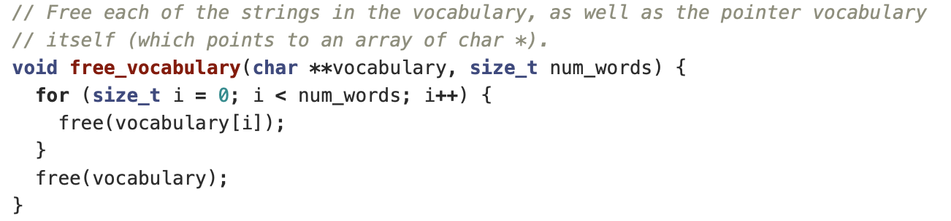
free_vocabulary - analysis
Why does free(vocabulary[i]) work?
free(NULL) is a No-op - it just ignores the call

